Slide 1
WEB524 WEB PROGRAMMING ON WINDOWS WEEK 9 – LECTURE 2 CUSTOM ERROR PAGES

Slide 2
Today
Gracefully handling request errors in an ASP.NET MVC web app.

Slide 3
Problem
For new ASP.NET MVC programmers, two request errors are often seen:
HTTP 404 – when a resource/page is not found.
Server Errors – If an unhandled exception occurs, possibly due to a logic error in your code.

Slide 4
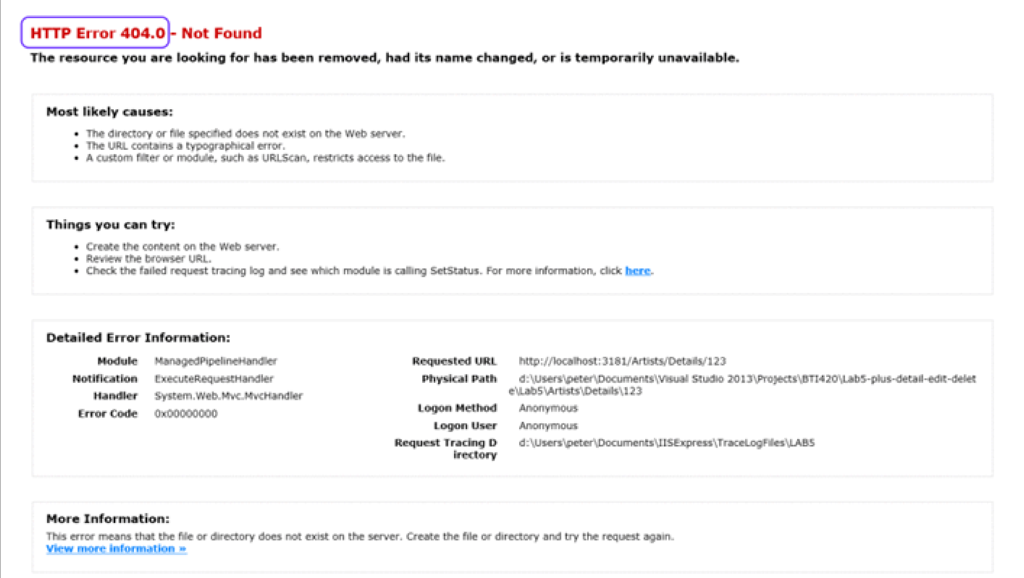

Slide 5
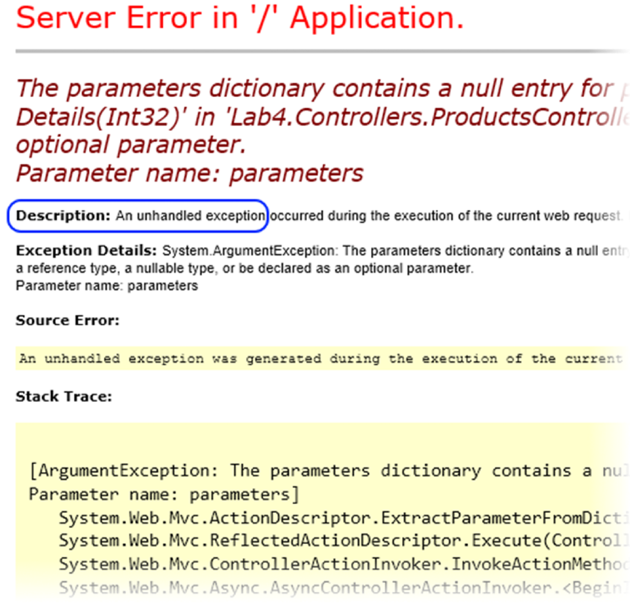

Slide 6
Default Error Pages
In both situations – or in any error situation – you should not show either error screen to your users.
Instead, add code to your project, so that a “not found” response looks more like this:

Slide 7
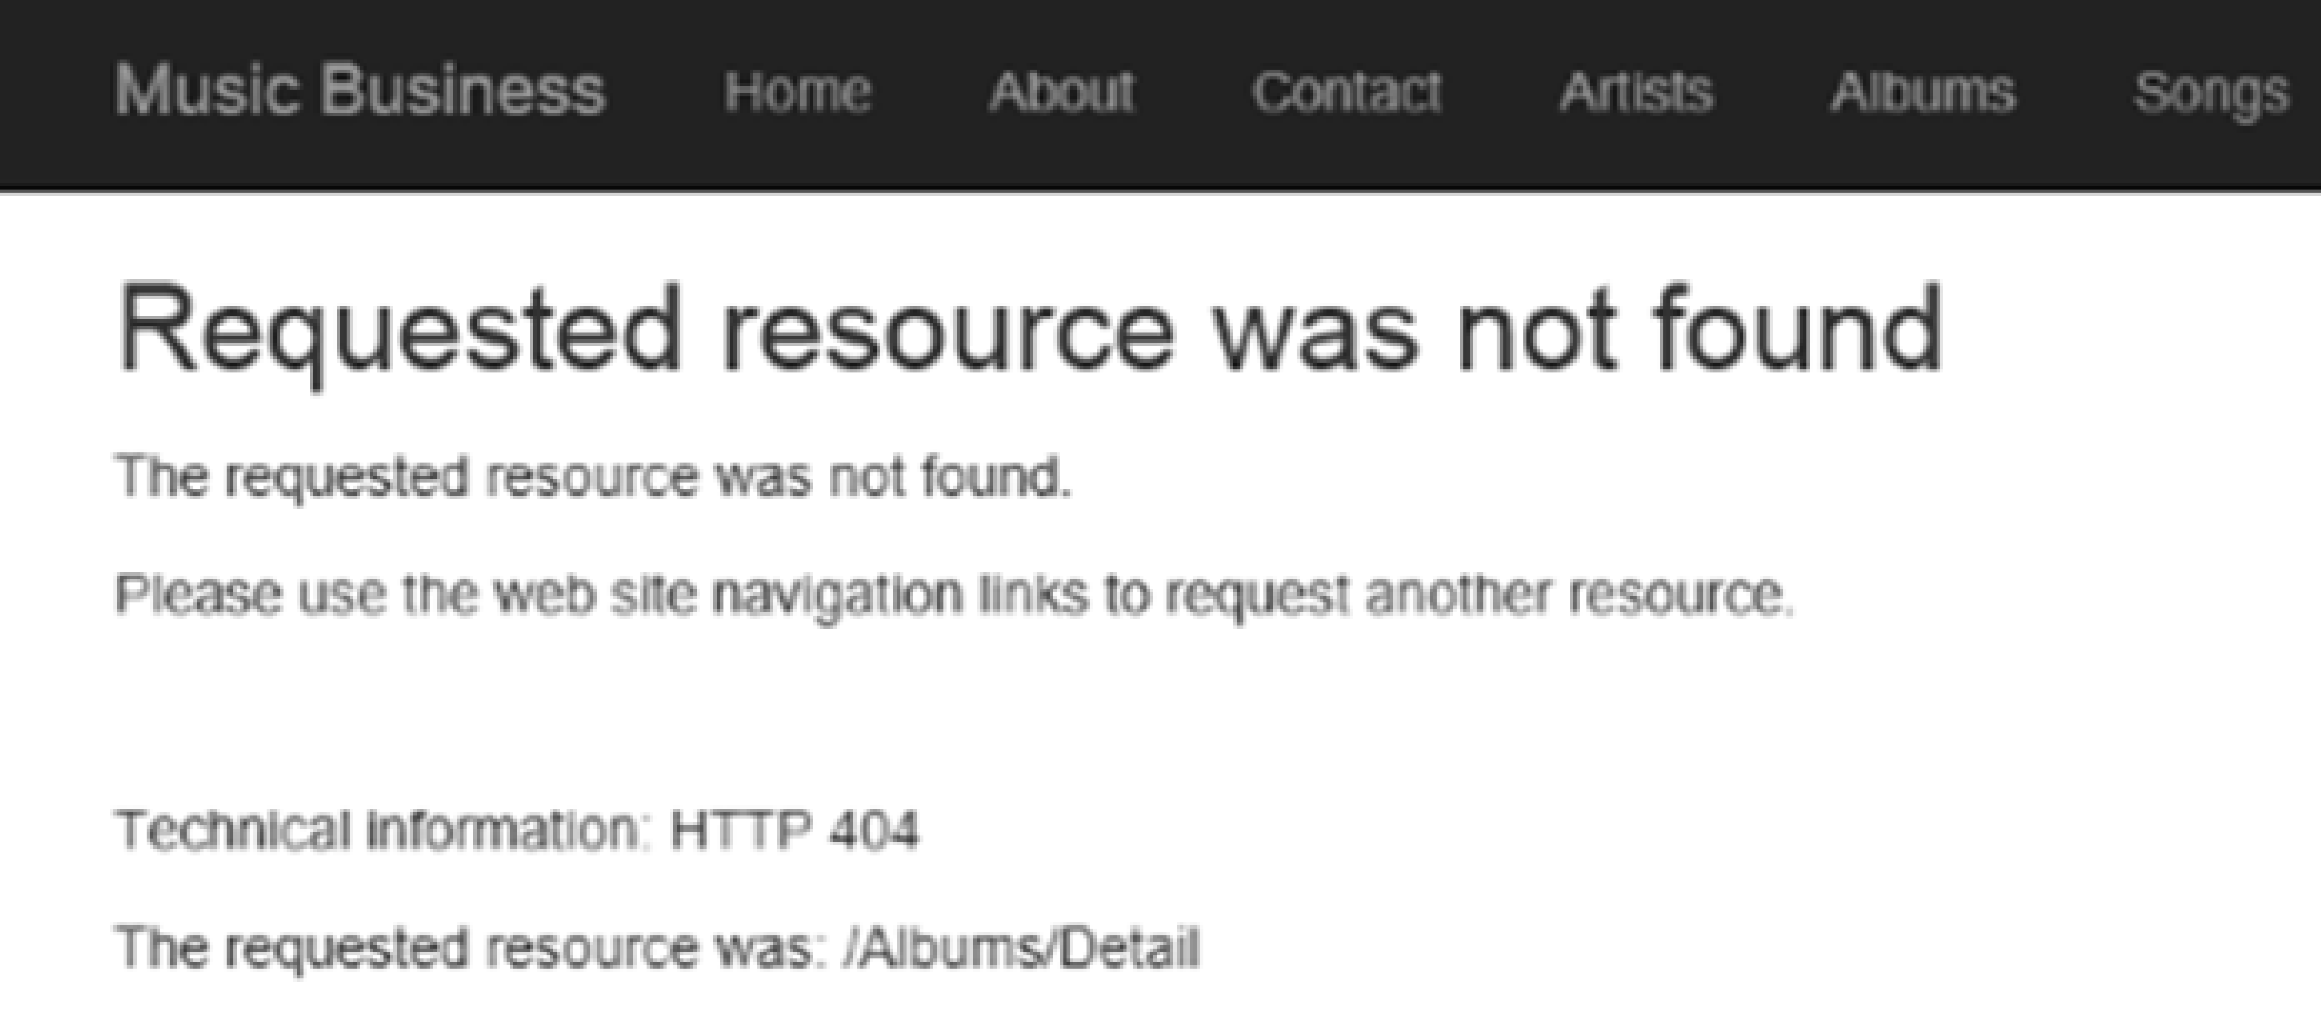
Example 404 Error

Slide 8
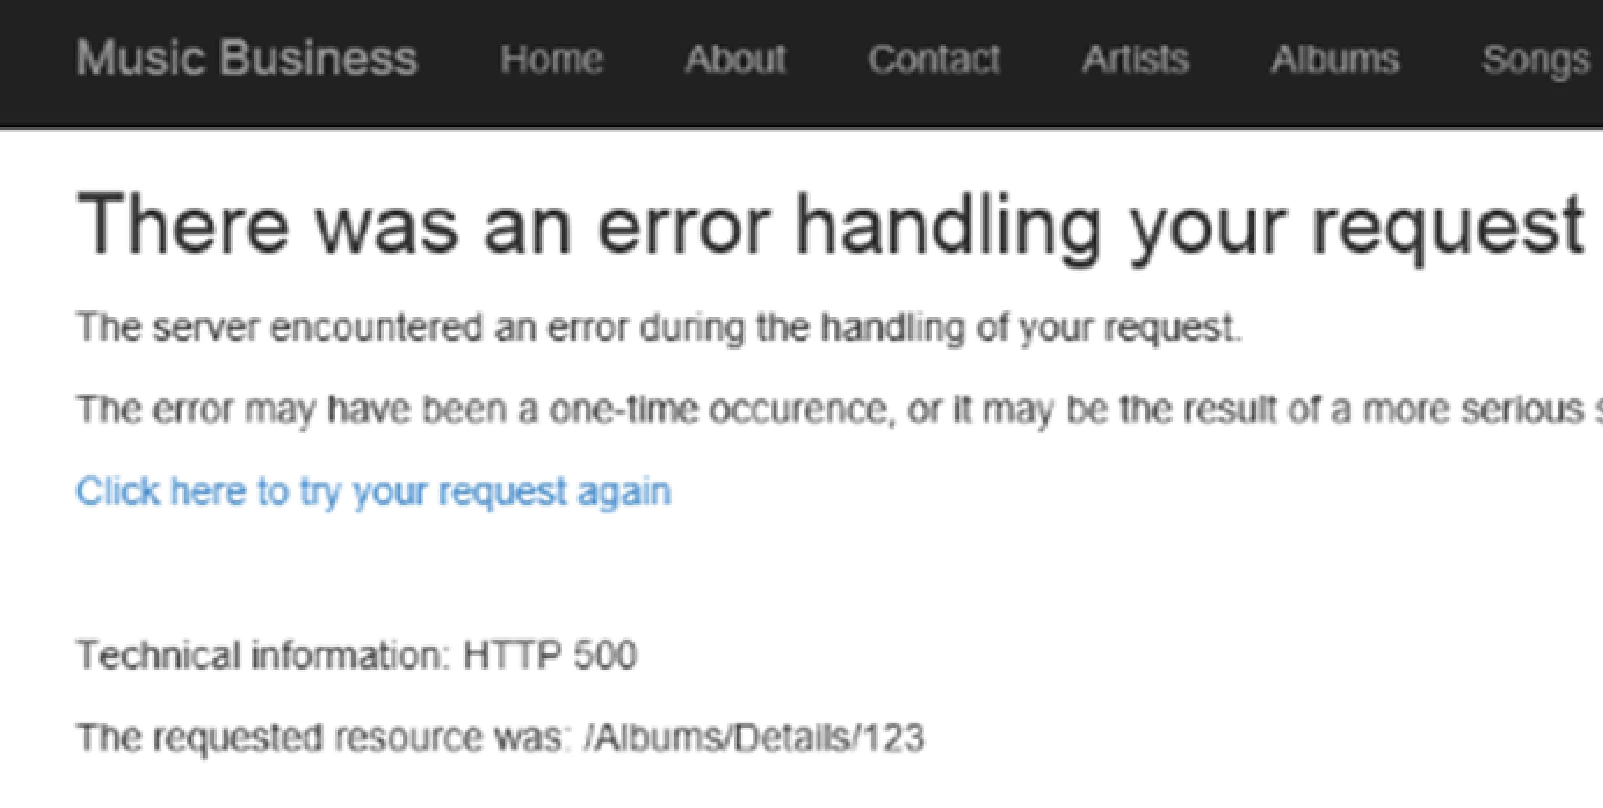
Example Server Error

Slide 9
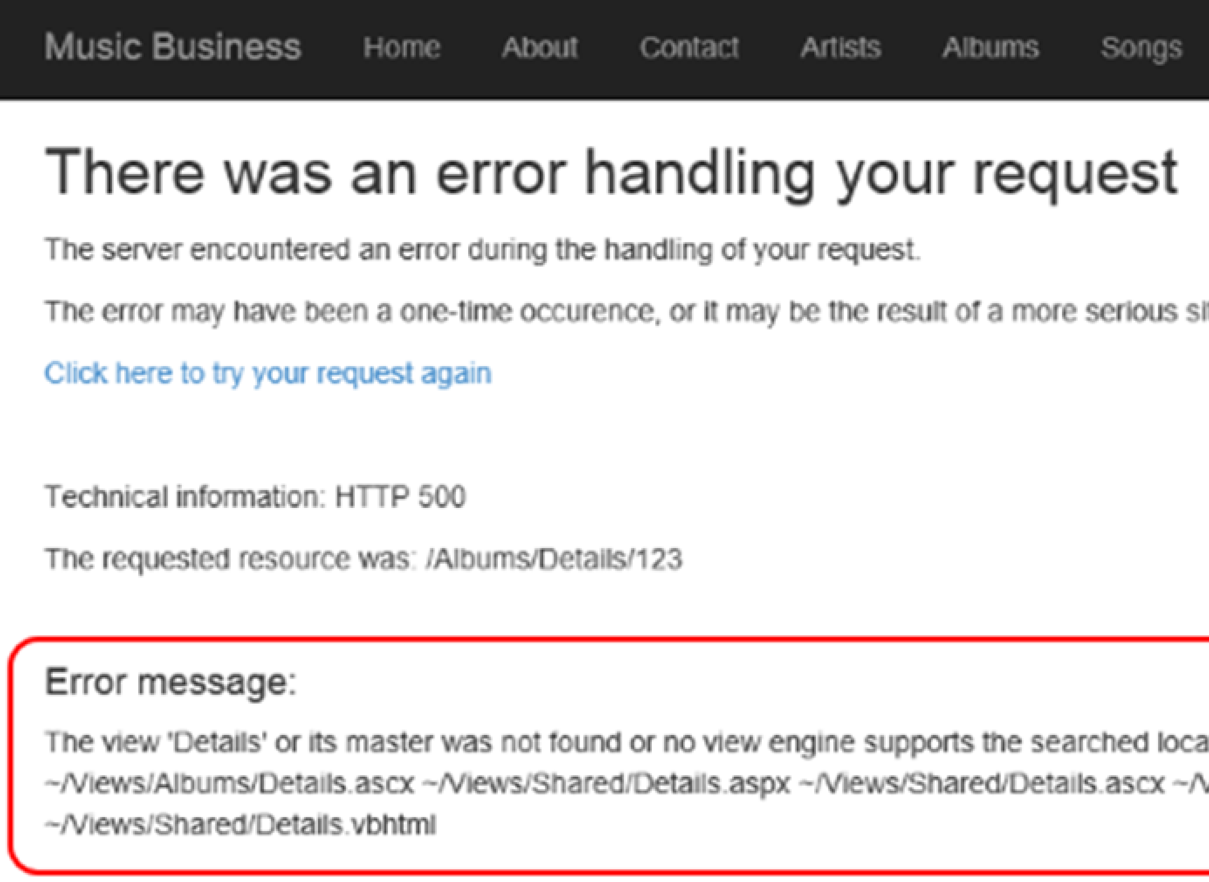
Example Developer-Only Error

Slide 10
Designing 404/500 Pages
Writing a suitable 404 or 500 page can be a serious yet amusing undertaking.
In a search engine, look for: custom 404 pages, custom 500 pages, or creative, or best
Look at some of the results for inspiration.
Google has some suggestions on how to create a useful 404 and 500 pages.
There are third-party (via NuGet) error logging frameworks that can be added to a project, which offer more features and functionality.

Slide 11
Adding error-handling to a project
Here’s how it works, we will add:
code to the project.
an ‘errors’ controller
some views
and another (event handling) method in the MvcApplication class.
The Web Application v2 Template already contains this error handling logic.

Slide 12
Add an ‘errors’ controller
Add an errors controller; you can use the ’empty’ template.
Change its class declaration to include the ‘sealed’ modifier:
public sealed class ErrorsController : Controller
Our solution will handle two types of errors:
Not found, and
Server error
The following slide shows some suggested code. We will use the ViewBag property to easily pass simple data to the view and avoid the need to create view model classes.

Slide 13
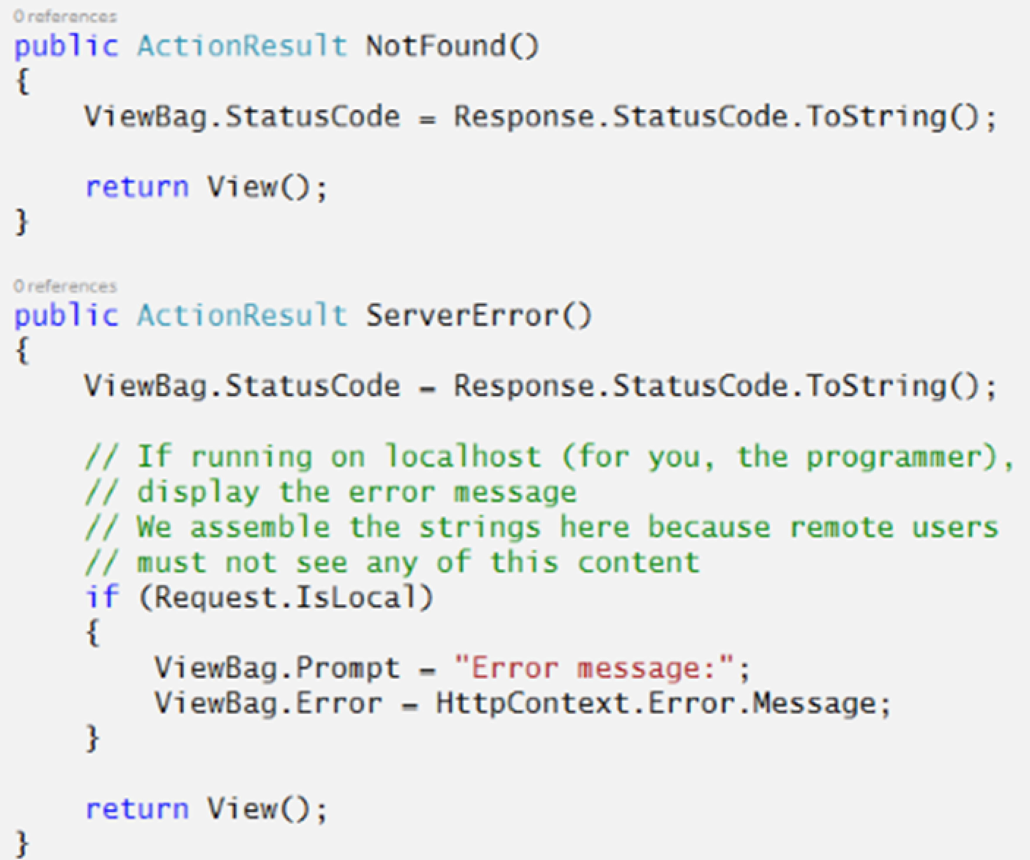

Slide 14
Add views for ‘not found’ and ‘server error’
Add views for the two methods.
You can use the ’empty’ template.
Add your own content to make a useful page.
You can implement the suggestions seen earlier.

Slide 15
Add methods to the MvcApplication class
We will write two methods in this class:
an event-handler, for “end request”
a private method to initialize the errors controller and call one of its methods

Slide 16
MvcApplication Class
In an ASP.NET MVC 5 web app, the instance of the MvcApplication class is created (by the ASP.NET runtime) when the first request is received.
The app’s lifetime is twenty (20) minutes after receiving a request (and this timer is reset with each new request). At the end of the app’s lifetime, the ASP.NET runtime gracefully terminates the app.
The purpose of the MvcApplication class is to handle events that happen during the app’s lifetime. In a web app, all events are triggered during the handling of an HTTP request.
The Global.asax.cs source code file holds the definition of the MvcApplication class. It includes code for the Application_Start() method, which is called by the ASP.NET runtime to handle the Start event, and thereby begins the app’s lifetime.

Slide 17
Implement MvcApplication Class Events
We can write methods to handle many events.
A few commonly handled events may include:
BeginRequest
EndRequest
Error
AuthenticateRequest
AuthorizeRequest

Slide 18
EndRequest Event
To implement our error handling system, we will write a method to handle the EndRequest event.
By convention, event-handling methods in the MvcApplication class return void, and have a composite name: Application_<event name>. For example, Application_Start().
To handle the EndRequest event, the declaration of its event-handling method will be:
protected void Application_EndRequest()
The following slide shows a sample implementation that handles HTTP status codes 404 (not found) and anything above 500 (server error)

Slide 19
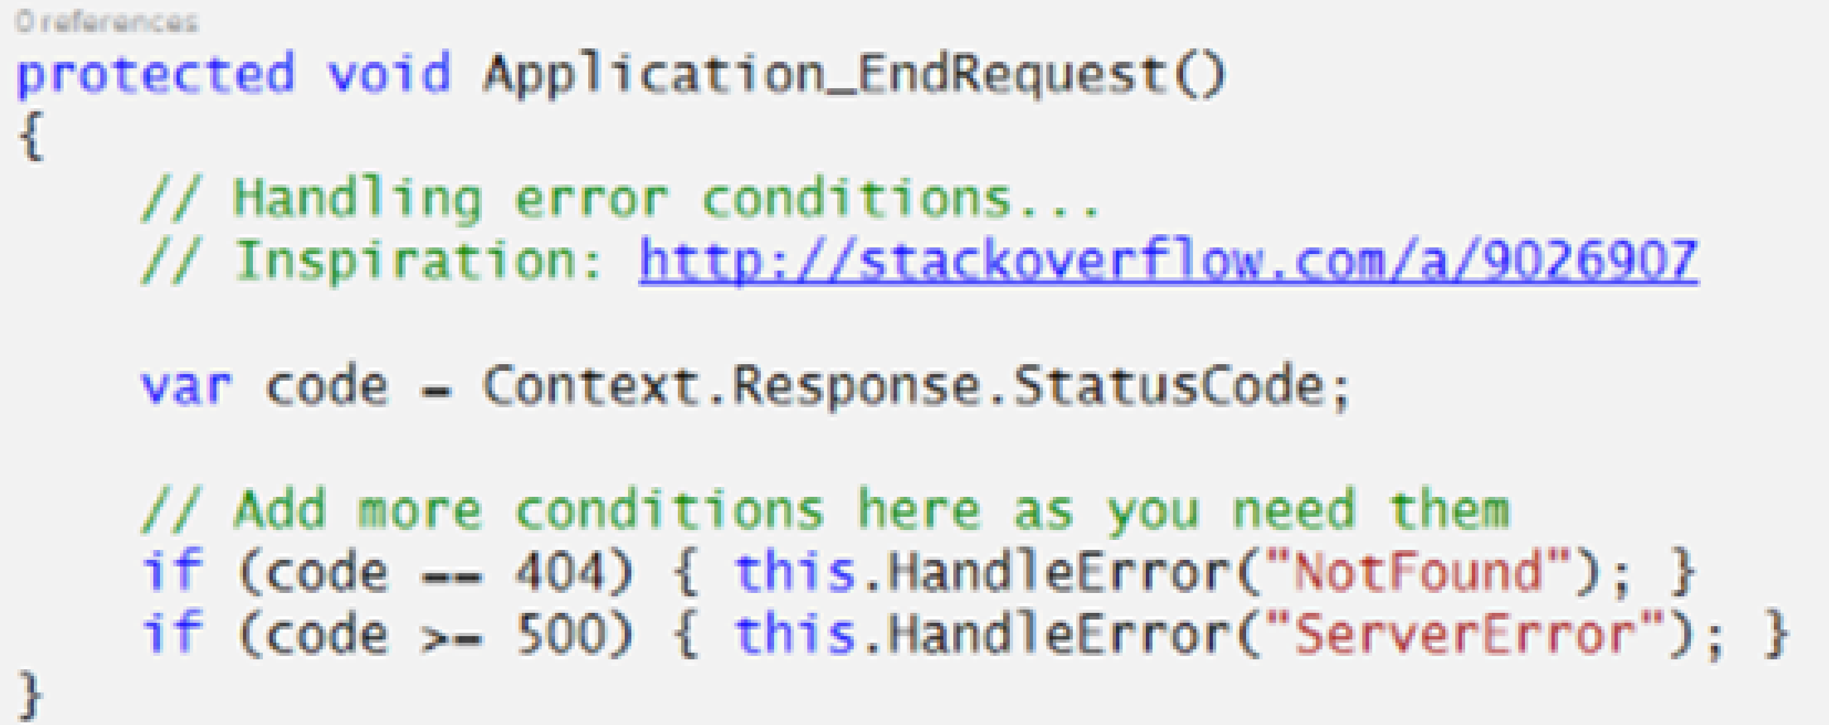
MvcApplication Code Snipped

Slide 20
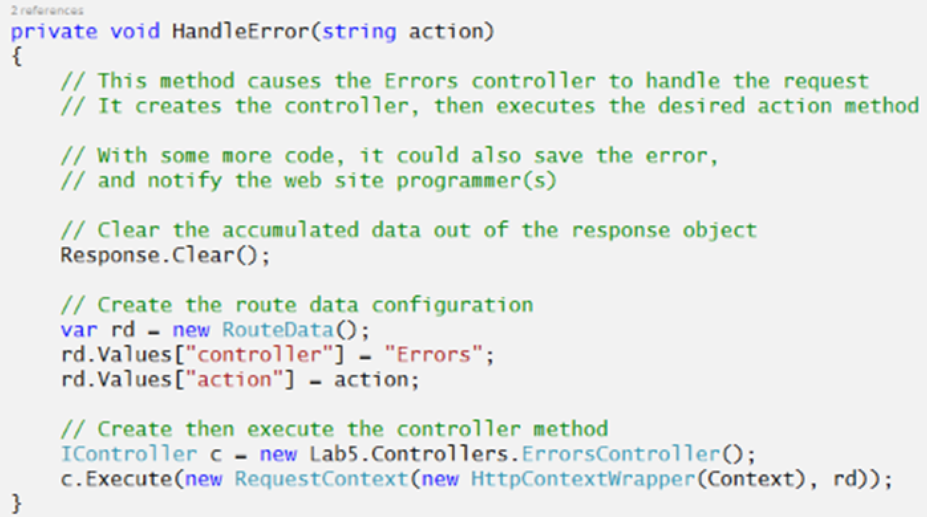
HandleError() Method

Slide 21
Optional Resources
The following resources were used to help assemble this document:
StackOverflow
MSDN – HttpApplication Class reference
MSDN – HttpApplication Events reference
MSDN – App Lifecycle Overview on IIS 5 and 6
MSDN – App Lifecycle Overview on IIS 7 (and 8)
K. Scott Allen – the HttpApplication class
Sebastian Solnica – Global.asax in ASP.NET

Slide 22
A little more on MvcApplication
An MvcApplication instance handles one request at a time.
The ASP.NET runtime will create additional instances of MvcApplication, to enable the app to handle multiple requests (in parallel) at the same time.
How many instances? That number is set by default at the webserver and can be changed by the webserver administrator.
While there may be multiple instances of MvcApplication running, the Application_Start() method runs only once at the beginning of the app’s lifetime.

Slide 23
Last slide on MvcApplication
If you are using the MvcApplication class to initialize global (to the app) state (e.g. data, resources), be careful.
Make sure that you use the different kinds of app state storage appropriately.
Recognize what kind of app state storage is global to the app (e.g.application state), and what kind of app state storage is local to a specific instance of an MvcApplication class (e.g. class-level properties and fields).

